Slide 1
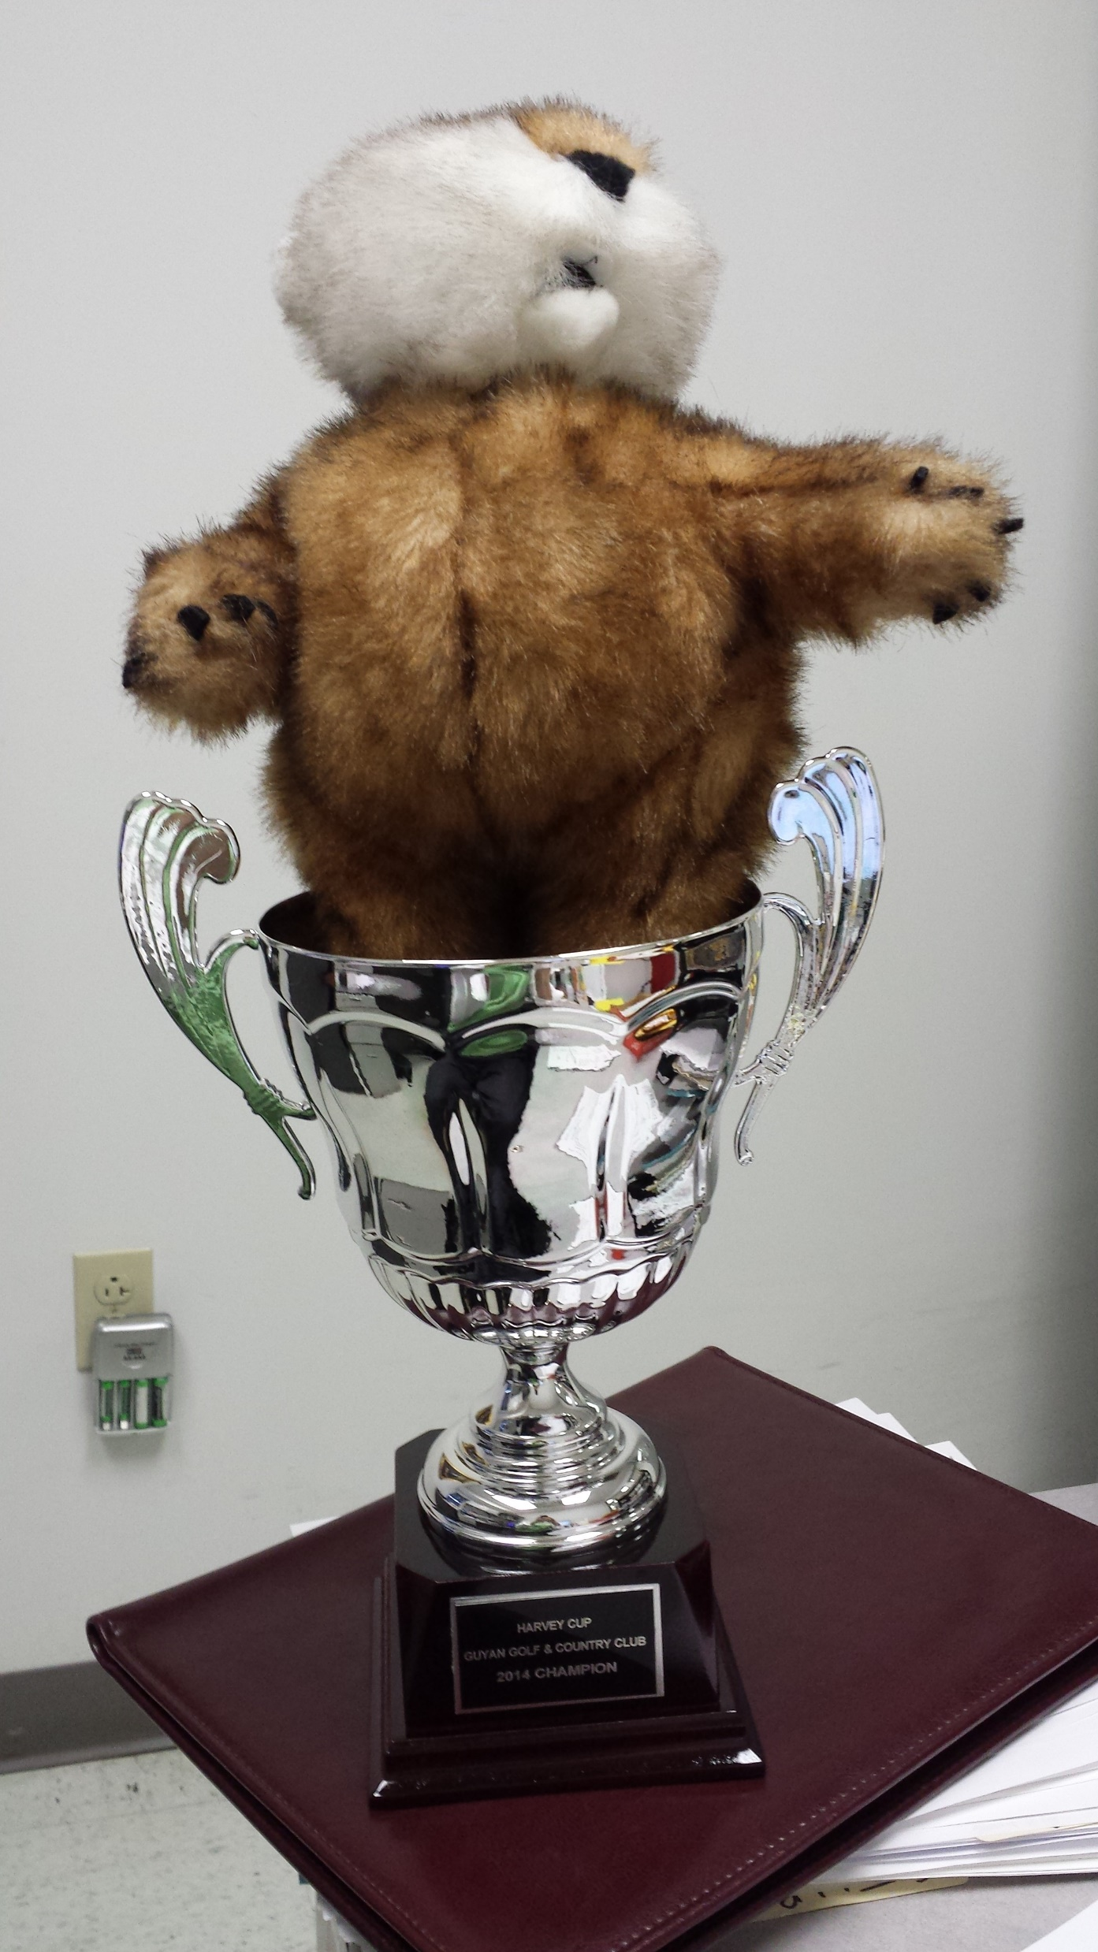
Wolf Rules:
We play $1 per point. We play one point for low ball and one point for low total. You also get points for net skins (winning the hole outright) – 1 point for par, 2 points for birdie, and 3 points for eagle
Double birdie bonus is in effect, but one of the birdies must be natural, not net
Junk – We play greenies and polies. Greenies are closest to the pin with validation (two putts or less).
Double greenie bonus comes into play if both partners are inside the other team (can’t get as wolf) and both must validate. No greenie carryover. Polies are any shot longer than the flagstick that goes in, on or off the green. You only get one opportunity for polie putting (and you can’t putt off the green and then chip in for polie
The order for wolf stays the same the whole game. The wolf hits first. Everyone else follows in the same order as before. If you declare wolf before anyone hits you are truly a man and you get an extra skin if you win the hole. Every player gets to be wolf on one par three. Tees will rotate weekly.
Everyone must go Wolf once per round during the first 16 holes. If you haven’t gone wolf by your 4th Wolf hole, you are going blind wolf without the additional skin (unless blind is called with at least 2 holes left)
Whoever the biggest loser is moneywise is the wolf on the last two holes. In case of a tie, Harvey points for the round will be the tiebreaker. If still tied, Harvey points for the year will be the tiebreaker. If still tied, flip a coin. If the same two are tied after 17, the loser of the tiebreaker is wolf on 18.
If you lose wolf, you lose low ball and low total to the other three players, plus junk when applicable. When you win as Wolf, it is the reverse, two points per player plus junk.
Wolf Cup 2022

